Slide 1
Dedicated Chatbot Using LLMs
Mohit Sharma

Slide 2
Introduction to Large Language Models (LLMs)
AI models designed to understand and generate human-like text.
GPT-3, GPT-4 (OpenAI), BERT (Google), T5 (Google).
Text generation, translation, summarization, question answering.
Enhances efficiency, accessibility, and drives AI innovation.

Slide 3
Introduction to Chatbots
AI applications simulating conversation with users.
Rule-based and AI-powered.
Customer support, personal assistants, information retrieval.
Natural language processing, context management, and real-time responses.

Slide 4
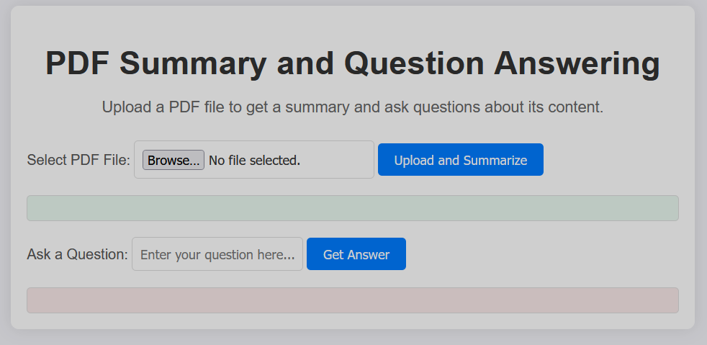
Frontend :-

Slide 5
Integrating with Backend
AJAX/Fetch API :- Send user queries without reloading the page.
Real-Time Communication:- Use WebSockets for instant responses.
Data Binding:- Update frontend based on backend responses.
API Endpoints:- Connect to backend services for data retrieval.
Flask Framework:
Lightweight and flexible Python web framework.
Handles HTTP requests and responses efficiently.
Machine Learning Integration:
Use libraries like TensorFlow or scikit-learn for machine learning models.
Integrate models to process data and generate predictions within Flask routes.

Slide 6


